Slide 1
SIM GAME
Minh Nguyen, hau ha

Slide 2
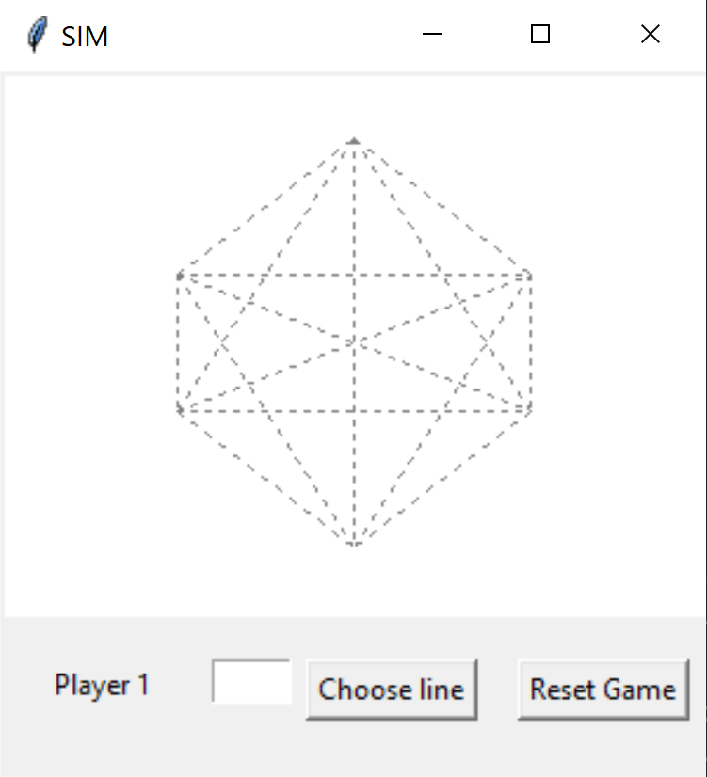
OVERVIEW
Zero Sum game
Two players take turn take turns coloring any uncolored lines (15 possible lines)
One player colors in one color, and the other colors in another color
The goal is to avoid drawing a triangle
Only triangles with the dots as corners count, intersections of lines are not relevant
Player who completes a triangle of the same color loses immediately
Each line is labeled with a letter from ‘a’ to ‘o’

Slide 3
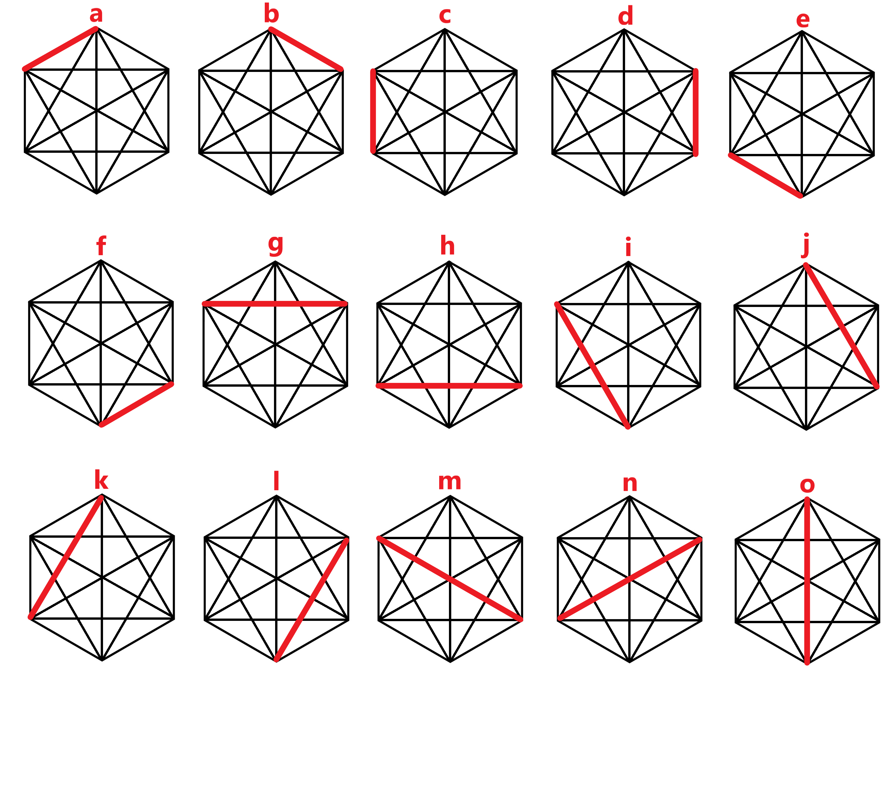

Slide 4
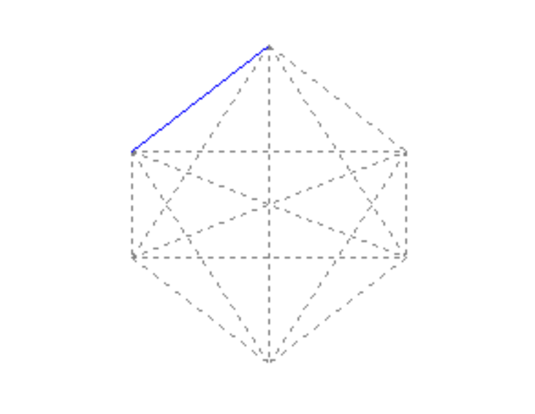
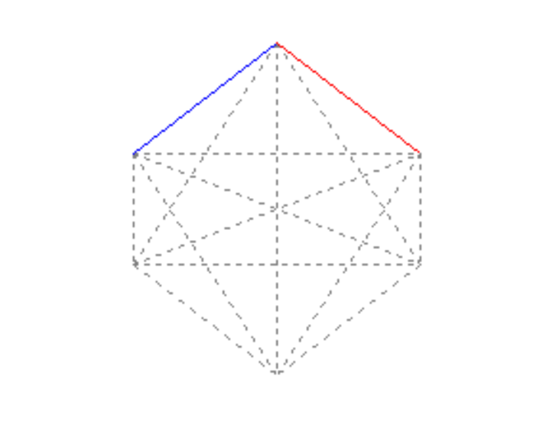
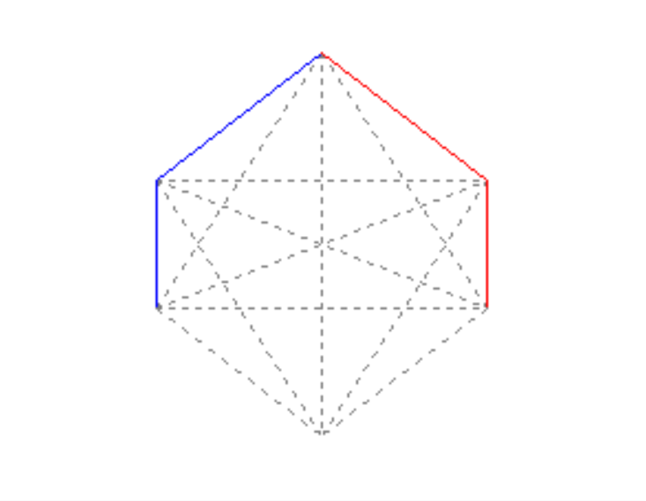

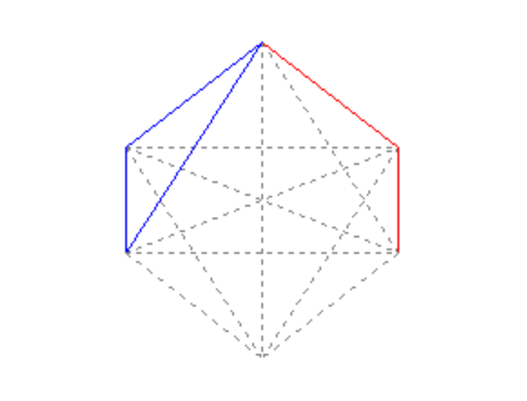
GAMEPLAY EXAMPLE
a
b
c
d
b
YOU LOST!
k

Slide 5
GENETICS ALGORITHM (GA)
GA is an innovative approach composed of many biological imitations, such as the chromosome representation, genetic operators, population selection, and fitness functions
GA represents a practical and no sweat approach to finding a solution by letting the machine try different solutions in time until we get a good approximation to the best solution.

Slide 6
INPUTS
Function F = a – b*depth
Range: 69 < Ca < 151, 0 < Cb < 4
Population: 10 chromosomes
Generations: 4 generations
Target chromosome C = [75, 2]
Mutation probability = 0.01
Always select top 4 chromosomes

Slide 7
INITIAL POPULATIONS
chromosome C = [134, 3]
chromosome C = [97, 3]
chromosome C = [72, 2]
chromosome C = [104, 3]
chromosome C = [100, 2]
chromosome C = [95, 1]
chromosome C = [110, 1]
chromosome C = [91, 2]
chromosome C = [102, 3]
chromosome C = [143, 3]

Slide 8
NEXT GENERATION (2nd)
chromosome C = [91, 2]
chromosome C = [97, 3]
chromosome C = [72, 2]
chromosome C = [97, 3]
chromosome C = [91, 2]
chromosome C = [95, 1]
chromosome C = [72, 2]
chromosome C = [91, 2]
chromosome C = [97, 3]
chromosome C = [72, 2]

Slide 9
NEXT GENERATION (3rd)
chromosome C = [72, 2]
chromosome C = [91, 2]
chromosome C = [72, 2]
chromosome C = [91, 2]
chromosome C = [72, 2]
chromosome C = [72, 2]
chromosome C = [72, 2]
chromosome C = [91, 2]
chromosome C = [91, 2]
chromosome C = [72, 2]

Slide 10
NEXT GENERATION (4th)
chromosome C = [72, 2]
chromosome C = [72, 2]
chromosome C = [72, 2]
chromosome C = [72, 2]
chromosome C = [72, 2]
chromosome C = [72, 2]
chromosome C = [72, 2]
chromosome C = [72, 2]
chromosome C = [72, 2]
chromosome C = [72, 2]

Slide 11
RESULTS
For generation 4th:
Best chromosome C4 = [72, 2]
Best performance F = 18
Average performance F = 16.5

Slide 12
Thank you for listening!

